Slide 1
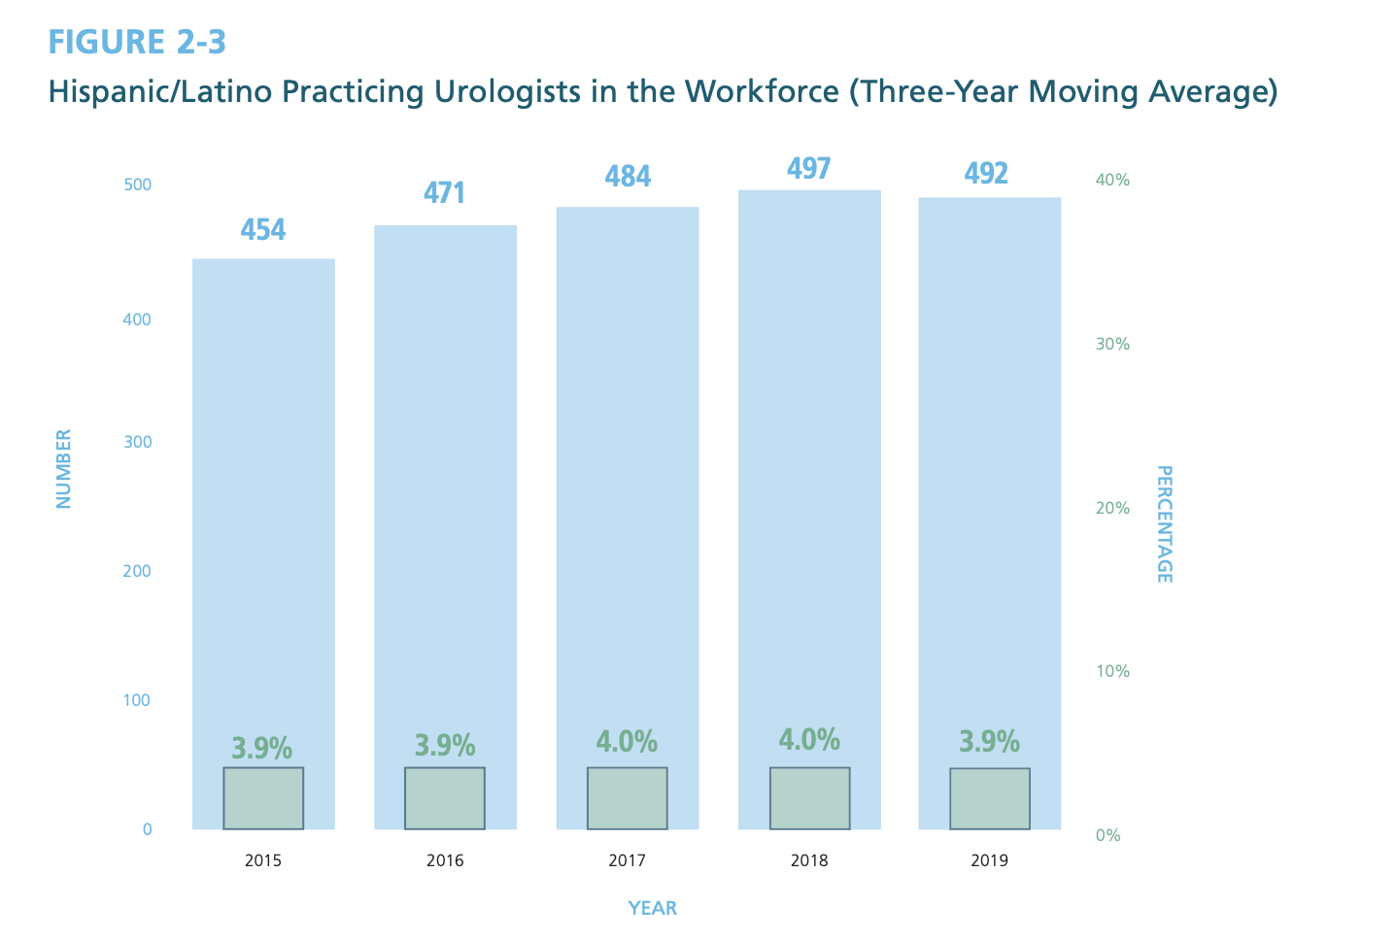
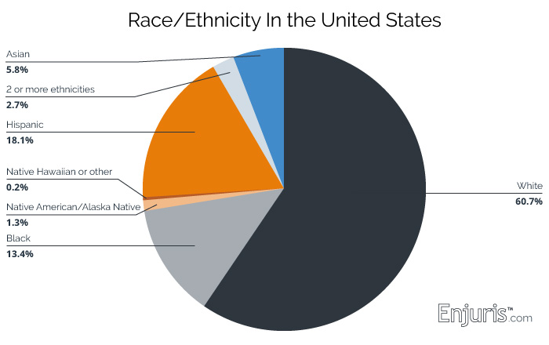
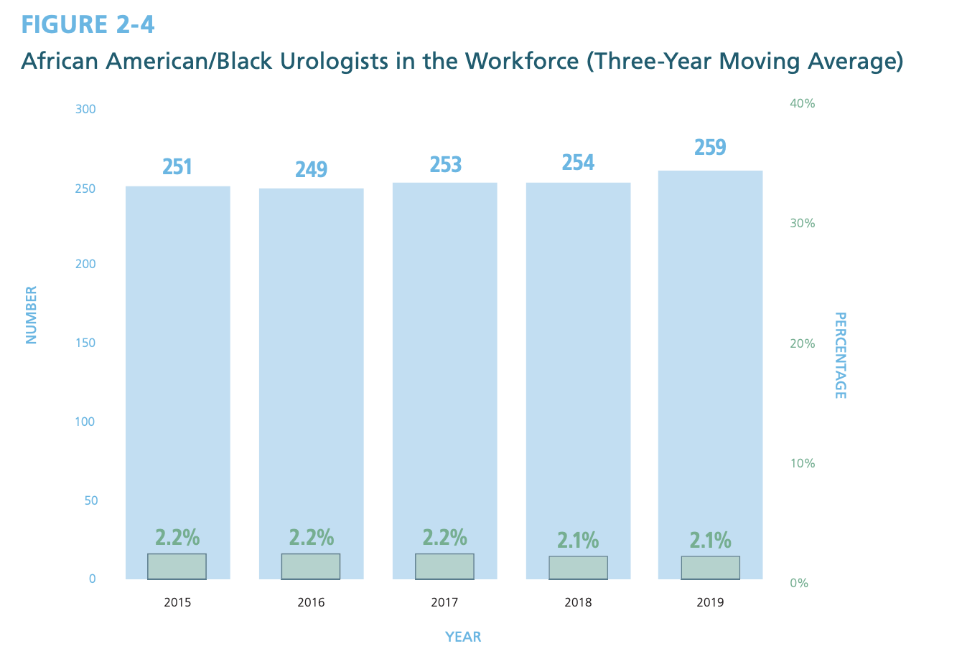
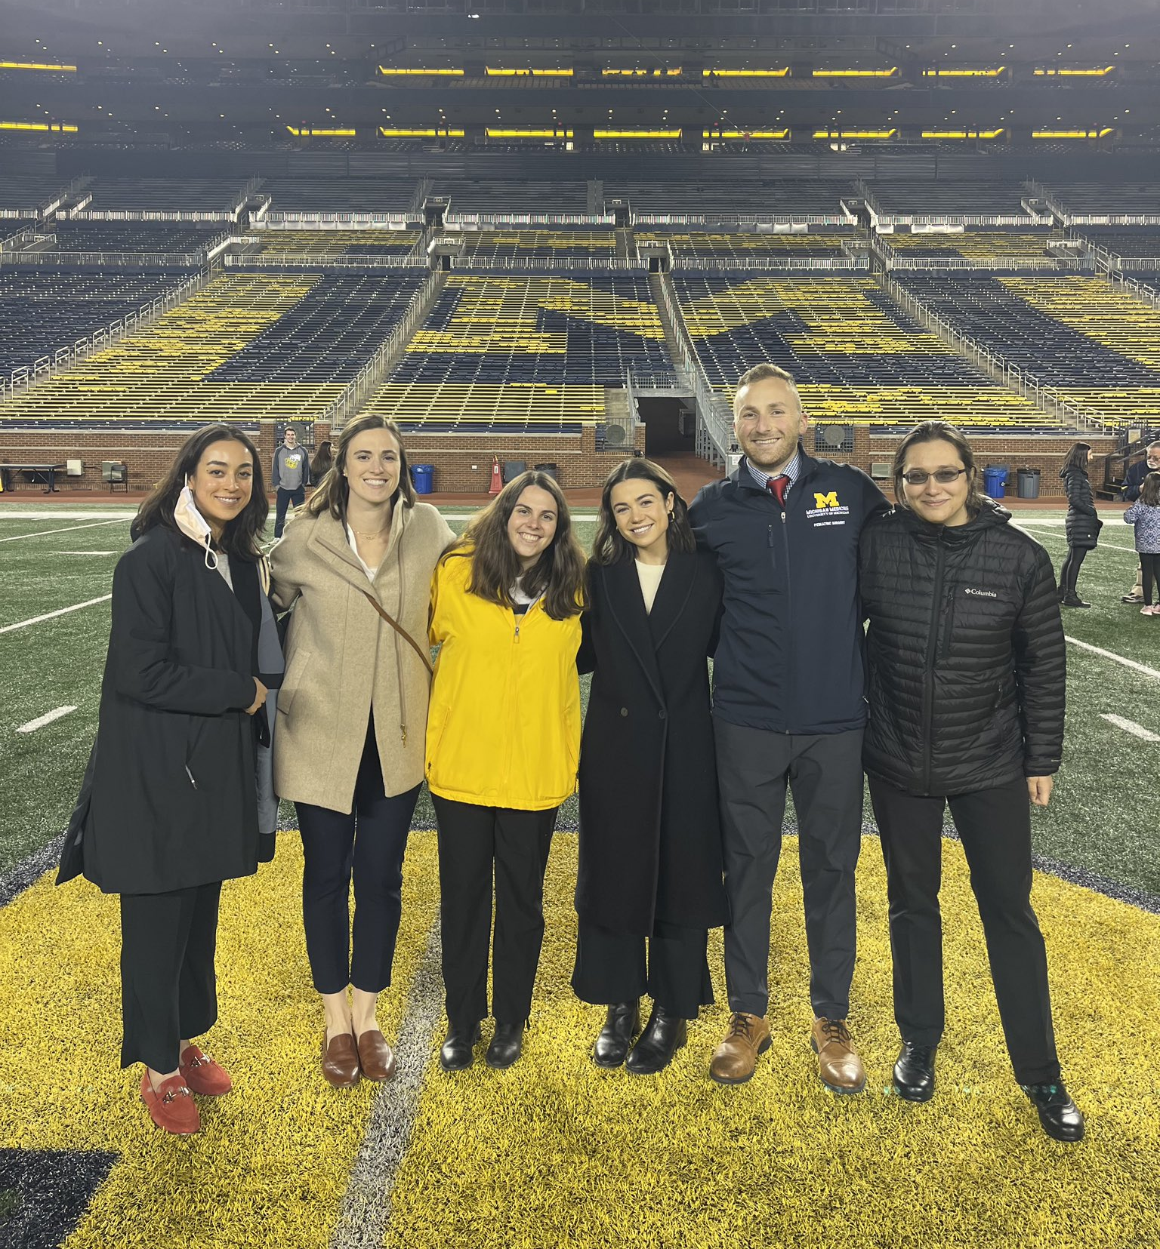
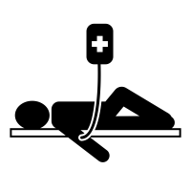
UroVersity: a Longitudinal Pipeline Initiative Designed to Support DEI
and Discovery within Urology
Charlie Ferreri, Hannah Glick, Rebecca Howland, Emma Bethel, Milan Patel, Kristian Black, Priyanka Gupta, Kate Kraft
Background
Results
Lessons Learned
It has been well documented that a diverse healthcare workforce leads to overall better patient outcomes; however, diversity is lacking in the field of urology. Data from the American Urological Association’s 2020 report on the State of the Urology Workforce and Practice, exhibits this lack of representation. For example, of the reported practicing urologists (12,733), only 2.1% identify as African American/Black. Regarding ethnicity, only 3.8% of practicing urologists identify as Hispanic. With respect to gender, the urological workforce was only 10.3% female. These data have remained relatively stagnant over recent years. Students who identify as Underrepresented in Medicine (URiM) face unique barriers and may face difficulty in access to opportunities or experiences that bolster their applications to residency. Given this, the importance of dedicated guidance via mentorship and early exposure within the field of urology is invaluable. Recognizing the above representation gaps along with the importance of mentorship for URiM students, UroVersity, was established.
Four first year medical students who self-identified as URiM were inducted to the program as UroVersity mentees in the fall of 2021. They were introduced to the history and progression of Urology at the University of Michigan through the Annual Nesbit Conference. They were provided opportunities to attend learning conferences such as grand rounds and journal club and were provided with information on the field of urology and how to become a successful applicant. Each student participated in clinical experiences through shadowing of faculty in the clinic and OR. Each participant was paired with a resident physician mentor as a primary point of contact.
The 2021-22 academic year is the first year with mentee participants and several lessons were learned. First, in order to carry out a guided mentorship program, support from faculty and resident physician champions was necessary. Through this partnership, mentors were identified and financial support was gained. A second key lesson is that continuing to integrate feedback from student participants is crucial in the implementation of a successful program. Lastly, for a pipeline program to be intentional, it benefits from significant investment in multiple avenues or points of contact for students to rely on whether that be through their resident mentors, faculty mentors, or medical school peers.
AAMC Underrepresented in Medicine Definition (URM):
"Underrepresented in medicine means those racial and ethnic populations that are underrepresented in the medical profession relative to their numbers in the general population.”
Future Application and Next Steps
In the future, we plan to continue to support their professional development through programming and curriculum for years 2-4. Programming for later years will include funding for academic resources (such as study tools or question banks), opportunities to publish and present academic research, CV/resume building workshops, and preparatory workshops for residency interviews. Additionally, we will continue to offer the program for incoming first year medical students, who will progress through the program longitudinally. The structure of this program can be adopted by other medical schools to increase representation and diversify physician workforce, both in the field of urology and beyond.
Objective
Oversite was created to increase diverse representation in surgical fields/urology through fostering relationships with underrepresented communities at the University of Michigan Medical School. UroVersity will close the gap by providing 1) active mentorship and 2) personal & professional development. UroVersity challenges physicians to learn about cultural differences, implicit and structural bias, acceptance, and develop strategies to maintain equity.
Acknowledgments
Priyanka Gupta, MD & Kate Kraft, MD, faculty advisers
Kristian Black, MD, MS founder and resident mentor
Jake Claflin, MD, Apoorv Dhir, MD, Daniel Triner, MD, PhD, resident mentors
Dawson Hill, Anna Khoroshilov, Kailyn Koh, inaugural mentees
Meidee Goh, MD, Associate Chair for Diversity Equity and Inclusion Committee
The Department of Urology Diversity Equity and Inclusion Committee
Methods
UroVersity was developed as an experience across all four years of medical school, the pipeline initiative seeks to engage students who identify as URiM by offering longitudinal mentorship, shadowing, and research opportunities. During their first year, medical students are paired one-on-one with both a faculty and resident physician mentor from the Urology Department at Michigan Medicine. Each semester they engage with faculty by shadowing in clinics and operating rooms (ORs) across the clinical divisions of urology. They are exposed to academic conferences, grand rounds lectures, research opportunities, and technical skills workshops. Lastly, there are several social events in order for participants to network and connect with others in the department.
AUA Census Data Estimating the Percentage of Hispanic/Latino and African American/Black Urologists Compared to the General U.S. Population
Mentee Benefits
Clinic and OR
Shadowing
Research
Networking
Academic
Conferences
AUA
Membership
ERAS & Interview preparedness
Population Benefits
Improve Patient Outcomes
Promote Health Equity
Increase Healthcare Efficiency
Better outcomes have been associated with higher cultural overlap between patients and physicians
Diversifying providers can increase patient compliance, rapport building, and improve overall health
Racial disparities are associated with 245 billion in economic losses annually
UroVersity Mentees and Student Leaders at the Big House Following the 35th Reed M. Nesbit Urologic Society & Visiting Professor Meeting
Funded: The Department of Urology, Michigan Medicine
@UroVersity_UM @CharlieFerreri
chferrer@med.umich.edu
Notes:
I made the authors match the abstract
Make sure you talk about infrastructure in the background section
Make sure the objective matches the objective in the abstract
You can pare down the analysis sentence by only saying that you did mixed effects multi-level regression
Distress wasn’t reported by self-report
Use the correct name of the A1c analyzer (i.e. Siemens….)
Insulin use and demographics were measured with the Diabetes Care Profile
I would represent the results in line graphs, so that the text you have in the results wouldn’t be needed
Change T0, etc in Table 1 to Baseline, 3, 6, etc

