Slide 1
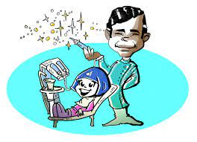
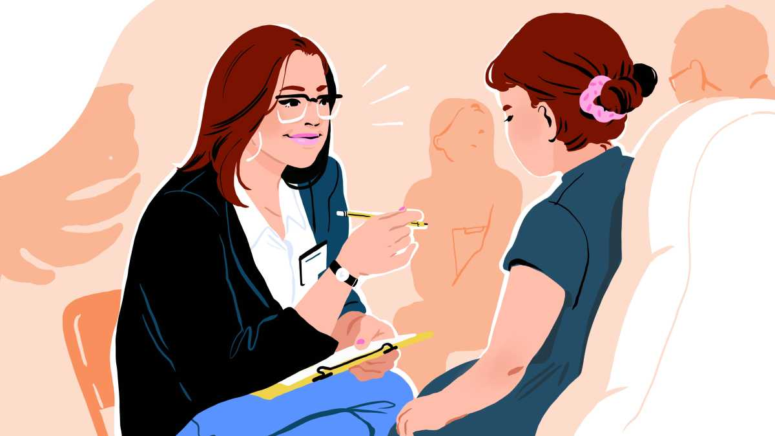
Social, Medical, and Dental components of Integrated pediatric care
Marcia Campos, School of Dentistry; Priscilla Hohmann, School of Medicine; Rosalva Osorio, School of Social Work
Background
Methods
Results
Interprofessional collaborative practice focuses on improving the healthcare of individuals and communities, reducing costs, and increasing value. Yes, most health professionals are trained to demonstrate skills and competencies specific to their own profession, which may contribute to challenges in providing effective collaborative care . To address this, health profession educators are now preparing students to demonstrate skills and competencies both professionally and interprofessionally through interprofessional practice and education (IPE). Even though students are gaining the educational background necessary to work on teams, there is growing emphasis on incorporating experiential IPE activities to better prepare students to shape the future of the healthcare system.
1st meeting
1. Intro/Icebreaker
2. Directions
3. Pre-survey
4. Videos-Teamwork
5. Case assignment
2nd meeting
1. Preparation for patient encounter
2. Focus on competencies
3. Preceptors will facilitate
The anticipated results for this ongoing project include student learning outcomes and patient outcomes. Students’ outcomes include:
Improving IPE collaboration skills by knowing better the “Roles and Responsibilities” of each profession involved in the project (Dentistry, Medicine and Social Work).
Improving knowledge and practicing “Values and Ethics” concepts by interacting with a real patient and playing an active role as a member of a healthcare team;
Improving communication and teamwork are secondary outcomes that will also be assessed during the project.
These outcomes will be assessed by:
Pre-survey: assessing students’ IPE background;
Use of the Jefferson Tool: Preceptors will evaluate student’s ability to work as a team using the Jefferson Tool;
Post-survey/Reflection: Assessing conceptual changes on IPE concepts after the activity and learning experience. Feedback about the activity and gains in terms of teamwork and communication skills will be encouraged during the last session, which includes a case presentation and discussion.
Patient outcomes will also be considered to demonstrate the impact of the project not only on the students’ learning experiences but also on the patient’s benefits.
Patient outcomes include:
Receiving IPE education, tailored and customized person-centered treatment plan including social, dental, and medical needs, as well as goals to improve dental, mental, and overall health. These benefits will be assessed by a satisfaction survey to be completed by family member/caregiver during the last encounter.
Long-term assessment will be carried out after the activity by following the metrics presented by the patient, demonstrating that goals have been achieved (better compliance, appointment attendance, number of dental/medical procedures completed, social needs better addressed, impact on case prognosis)
Objective
Dental
3rd meeting
1. Sharing and debriefing (1st patient encounter)
2. Discussing needs
3. Creating Comprehensive Tx
1st Patient Encounter:
Gathering information
Medical
This experiential project aims to have dental, social work, and medical school students work together as an interprofessional team with a pediatric patient that is currently receiving care at the UM Dental Pediatric Clinic. After evaluating the patient’s medical, social, and dental needs, students will create a comprehensive treatment plan with the patient/family/guardian. They will then present a comprehensive list of to the patient/family/guardian to choose from. With this interprofessional and person-centered approach it is expected that the students will be able to recognize the importance of working in teams to improve patient’s outcomes.
Social
Lessons Learned
2nd Patient Encounter:
Presenting Smile Care Treatment Plan
& Patient survey
Dental
4th meeting
1. Sharing and debriefing (2nd patient encounter)
2. Feedback
3. Post Surveys
Dental
Medical
We learned that developing a robust experiential IPE project requires much careful planning to ensure that the activity is meaningful and achievable. Coordination and communication among the various health professions can be challenging as schedules at the various schools do not always align. As this project is ongoing, we will continue to use the results from this pilot to improve our final course. We hope this project can be offered as an elective course through “Pathways” at the School of Dentistry; a field experience for MSW students; and possibly a Capstone for Impact (CFI) project with the Medical School to continue to bridge and expand the application and practice of IPE/IPCP.
Social
Metrics
Medical
Social
Learning outcomes and IPE background will be measured by using the Jefferson Tool, student surveys (pre- and post-activity), as well as a pos- activity patient satisfaction survey.
Future Application and Next Steps
The next step of this project will be running the pilot, involving one group of students to make sure the length, content and flow of the sessions are sufficient, contact with patients and family members/caregivers are feasible and meaningful, and the outcomes are mostly achievable. We expect that, in the near future, more experiential learning opportunities may be offered to students in health professional courses, and we hope this project will be expanded to different clinics of the School of Dentistry to contribute to student learning experience and improved patient outcomes.
Comprehensive Treatment Plan
IPE Competencies
Roles & Responsibilities
Values & Ethics
Students Outcome:
Improve IPE skills through better understanding of Roles and Responsibilities and by applying Values and Ethics (real case)
Patients Outcome:
IPE education, customized person-centered treatment plan, and overall health improvement
Acknowledgments
Patient-centered care and treatment
Present project was approved by the IRB (HUM00210542).
This material is based upon work supported by the University of Michigan’s Center for Interprofessional Education, which was funded through the U-M Transforming Learning for a Third Century (TLTC) grants program.
Special thanks to Tazin Daniels, Vani Patterson, Malinda Matney, Lindsay Telega, and Lynne Synclair for their constant support and guidance.
2021-2022 IPE Fellows Cohort and previous Fellows for all their feedback throughout the development of this project.
Communication
Teamwork
Funding: U of M Center for Interprofessional Education through TLTC grants program
mscampos@umich.edu; phohmann@med.umich.edu; rosorio@umich.edu

