Slide 1
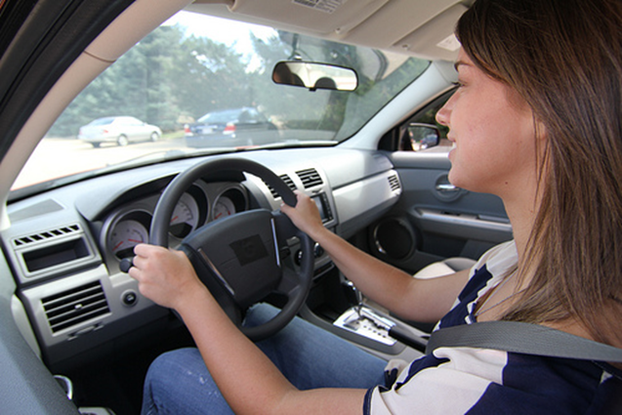
Department of Psychology
Transportation Orientation
Using a UM Vehicle:
Policies & Procedures

Slide 2
Contact Information
Psychology Student Affairs Office
  1343 East Hall
  Open: Monday-Friday, 8am-5pm
  Phone: 734-764-2580
  Email: psych.transportation@umich.edu
EMERGENCY AFTER BUSINESS HOURS:
  Call Transportation Services at: (734) 764-2490
  Refueling: 1213 Kipke Dr, Ann Arbor, MI 48104

Slide 3
Vehicle Use:
Vehicles may ONLY be used to go to site placement & back. (McDonalds & Starbucks are not authorized site placements).
The Driver will:
  Fill out a Vehicle Report Form, with every use
  Fuel the vehicle when appropriate
  Use only the vehicle reserved or assigned to them
  Report & record new damage
  Call the SAA office or email psych.transportation@umich.edu with questions or concerns.

Slide 4
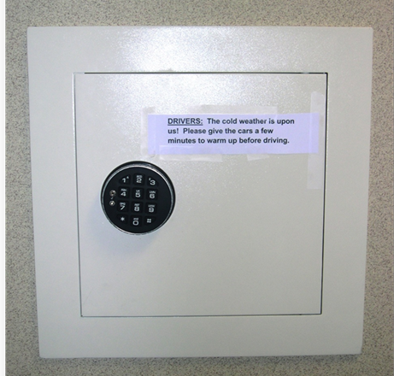
Lockbox Location
The lockbox is located on the wall outside of the SAA Office.
The lockbox code is not to be shared with anyone for any reason, including others in your group. Sharing the lockbox code will result in immediate loss of driving privileges.
Those who are approved to drive will be given the lockbox code by the Transportation Coordinator.

Slide 5
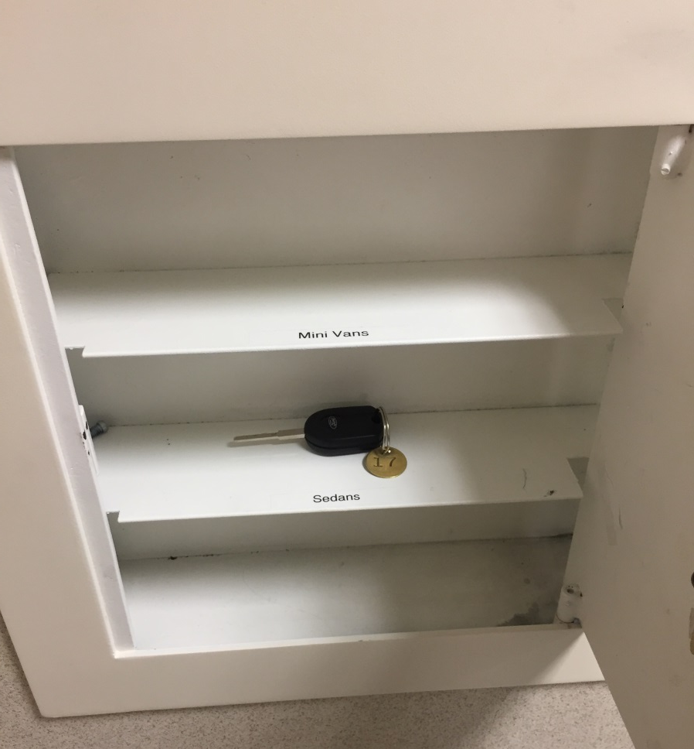
Vehicle Keys
All vehicle keys are kept in the lockbox and have a round brass tag with vehicle number.
Never take a car other than the one you have been assigned through your approved reservation.

Slide 6
Vehicle Photo Policy
Record any damage you find:
  Before leaving the Church St. structure
  Before leaving your site placement
Pictures must clearly show the damage.
These pictures will be used in the event that:
  Damage occurs to the car while parked in the garage.
  Damage occurs to the car while parked at your site.
More about this process in the Vehicle Report Form Module

Slide 7


Monitoring Vehicles
Mileage, fuel levels, and vehicle condition are monitored daily by the SAA office.
Any discrepancy in mileage or un-reported damage to the vehicle will be reported to both your GSI and faculty instructor and could result in the loss of driving privileges.

Slide 8
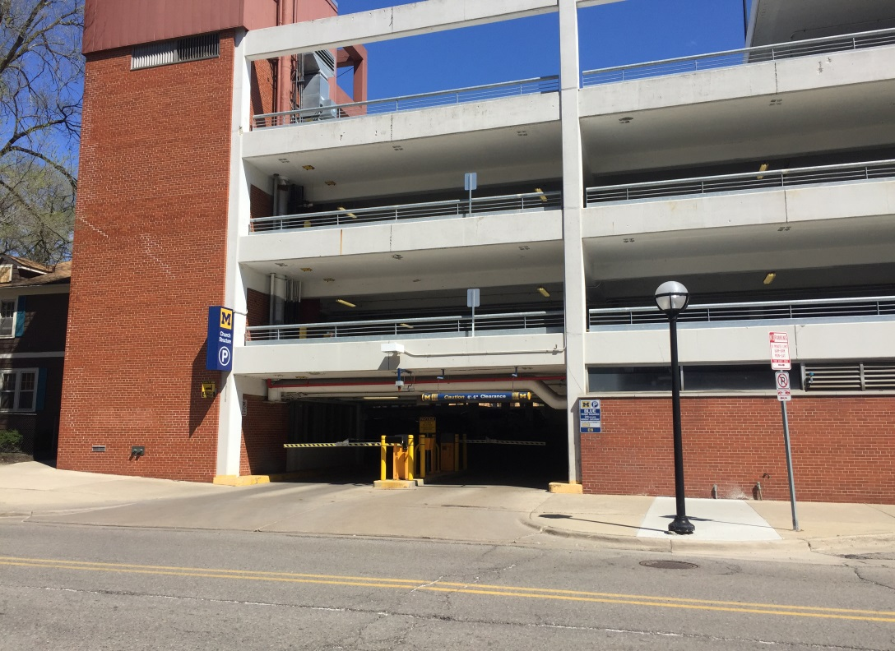
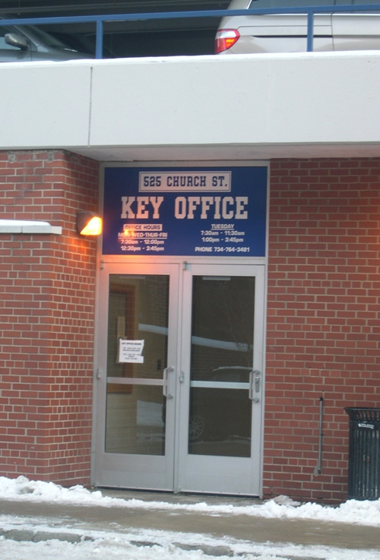
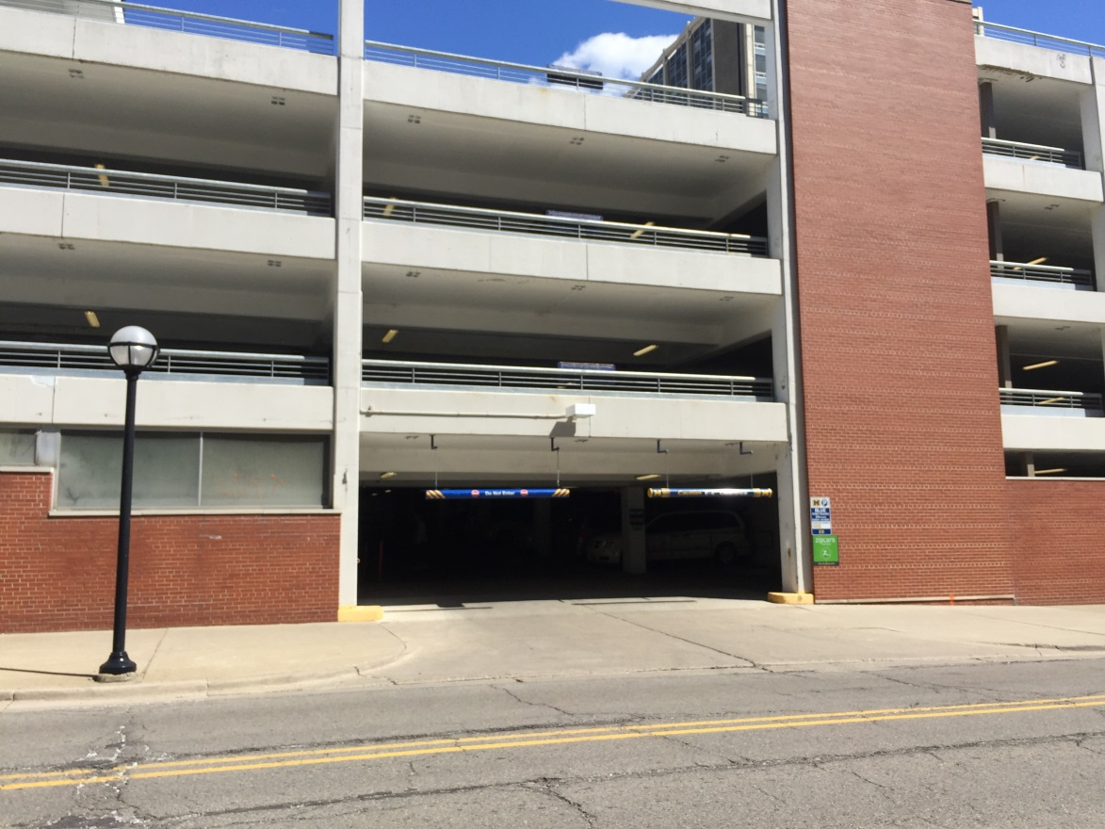
Parking
Vehicles are parked in the Church St. structure (across from East Hall)
The Church St. structure has two sides:
  Gated
    Open to vehicles with blue parking pass
  Ungated
    Open to UM vehicles only

Slide 9
Parking- Church St. Structure
North
Gated Entrance
South
Ungated Entrance
Key Office
(In the middle)
CC Little
South University

Slide 10
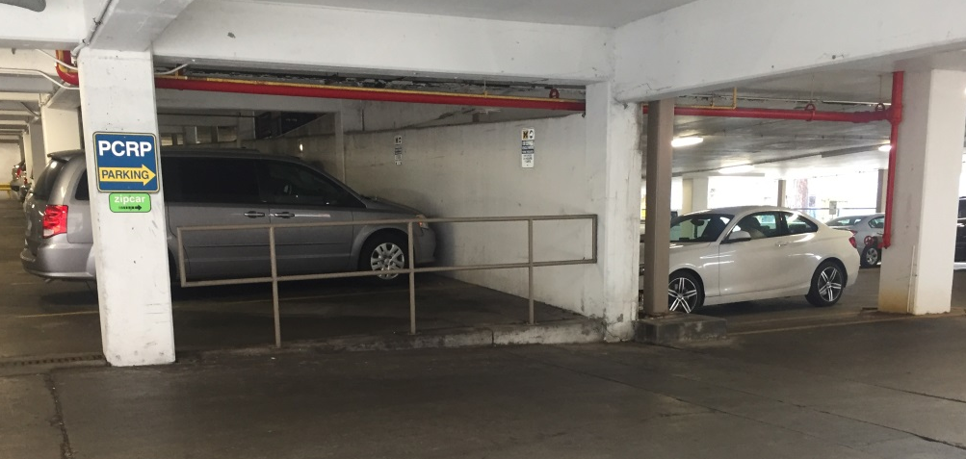
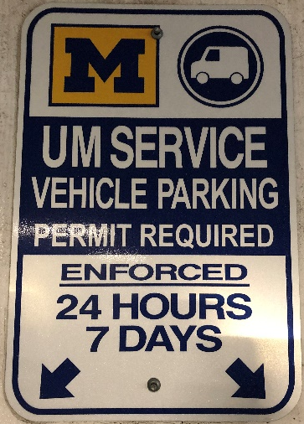
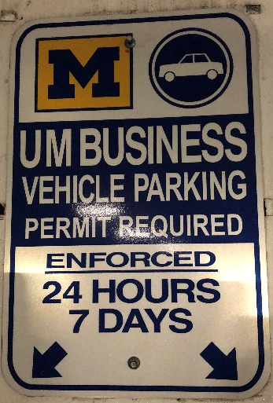


Parking
Gated
  Cars may be parked in any unmarked spot
  Please note the floor number and whether you were nearer to the north/south side of the garage on sign-in sheet
    South side is closest to South U
Ungated
  Cars may be parked in business spots only
  Be sure to indicate whether you’ve parked in the ungated left side or ungated right side (separated by a wall)
Ungated left
Ungated right

Slide 11
Parking
Cars are to be parked front first - never backed in or pulled through. The license plate must be visible from the aisle.
Park in business or unmarked spots only! Parking in others may result in parking tickets.
Parking spaces can be narrow. Be sure you’re between the lines (not on them), otherwise you may be issued a parking ticket by the City of Ann Arbor.
Please note: Drivers will be responsible
for any tickets issued.

Slide 12
Re-fueling
Re-fuel at ½ tank or less.
Some vehicles run on ethanol fuel, others run on unleaded you must get gas at Transportation Services behind Crisler Arena.
Transportation Services: 1213 Kipke Dr, Ann Arbor, MI 48104
There are chips in the gas tanks of all vehicles that activate the pumps, you do NOT pay for gas.
Fueling Station is closed Saturdays and Sundays.
  The last driver before the weekend is responsible for filling up the vehicle, so drivers on Sat/Sun will have fuel. You will be notified if you are this person.
Transportation Services is open 8am-11pm, M-F. If you have difficulty with the pumps, please ask for assistance in one of the Transportation Services offices.

Slide 13
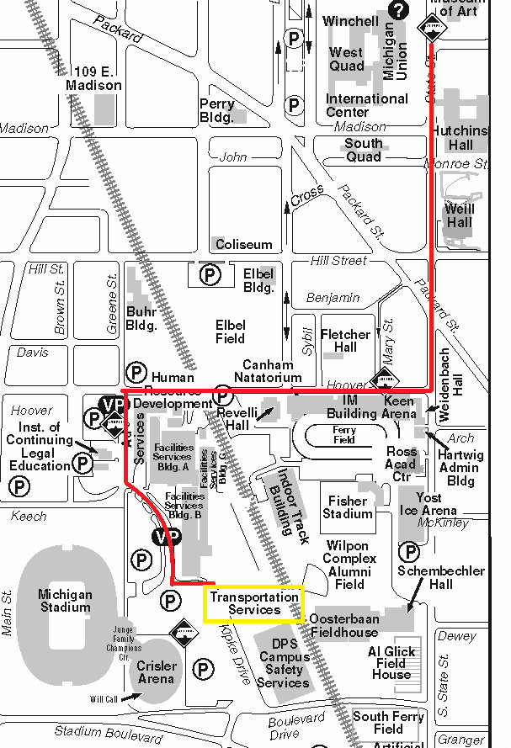
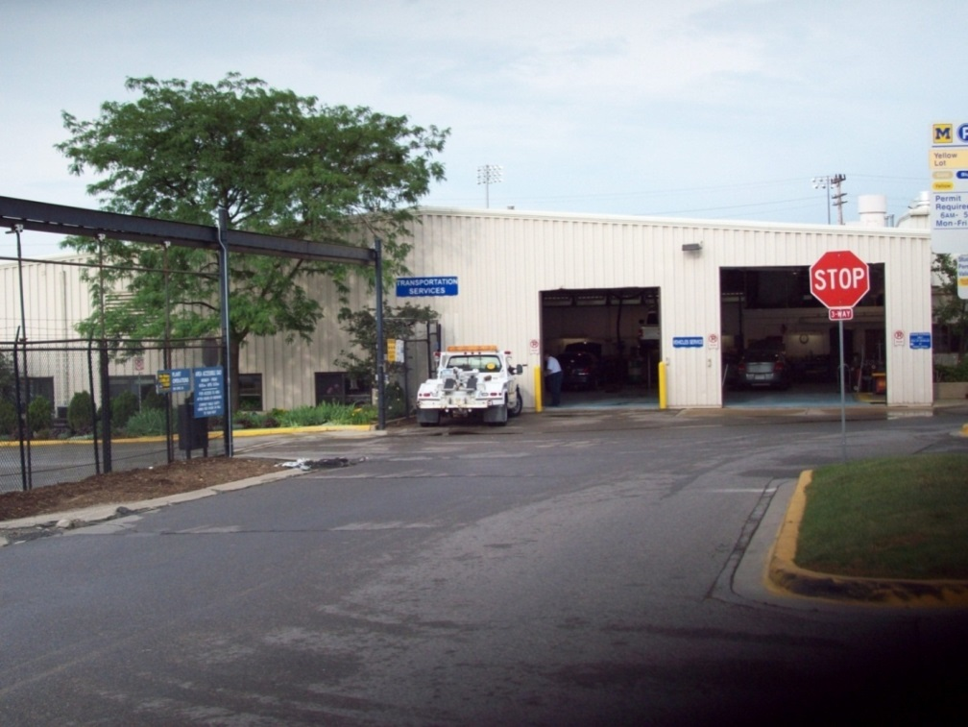
Refueling the vehicles at
Transportation Services
Transportation Services:
1213 Kipke Dr, Ann Arbor, MI 48104

Slide 14
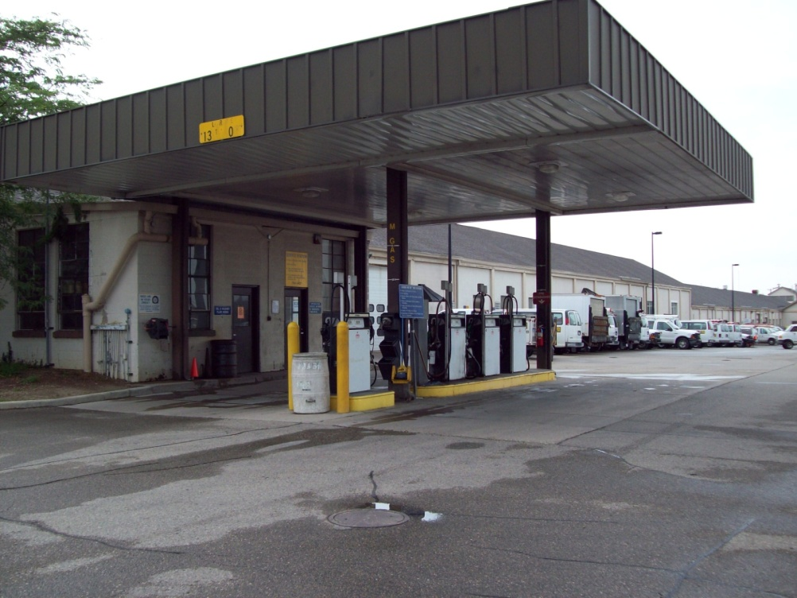
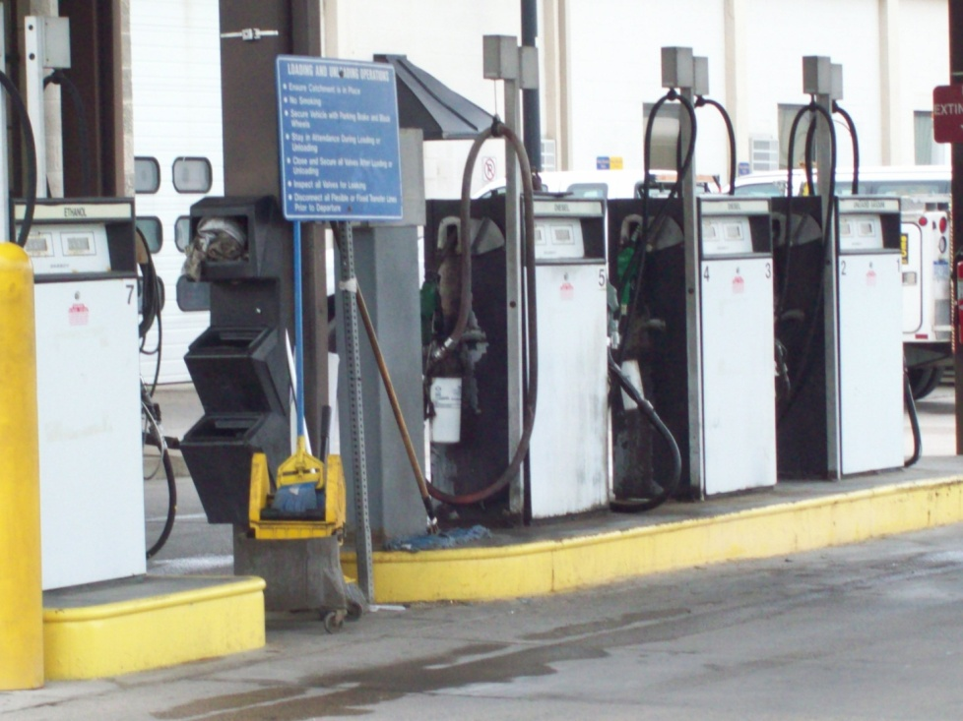
Refueling: Ethanol & Unleaded
Unleaded: Only
#1 or #2
Ethanol Only
#7 or #8
Flip the Lever

Slide 15
Damage to Vehicles
Any damage to vehicles must be reported to the SAA Office. Email:psych.transportation@umich.edu
When damage is newly reported, the driver may need to fill out an accident or incident report with the Transportation Coordinator in the SAA Office. The Transportation Coordinator will contact you if this is necessary.
Upload pictures of damage to the Vehicle Report Form.

Slide 16
Breakdowns and Accidents
If a breakdown/accident occurs Monday-Friday between 8am and 4:30pm, call the SAA Office.
  If a breakdown/accident occurs outside of office hours, call Transportation Services.
  Both phone numbers can be found on the driver’s visor.
If the vehicle needs to be towed
  Call Transportation Services.
  Third-party towing companies will not be covered by the department.

Slide 17
Accidents
The first priority is the well-being of the drivers and passengers. If anyone is injured, call 911 immediately.
If anyone needs medical attention, the SAA Office will need a copy of the physician’s report.
Call the SAA Office or Transportation Services. (Driver’s Visor)
If another vehicle is involved - get a police report, regardless of the level of damage.
If the vehicle needs to be towed, call Transportation Services.
Third-party towing companies will not be covered by the department.
Visit the SAA Office to complete an accident report.

Slide 18
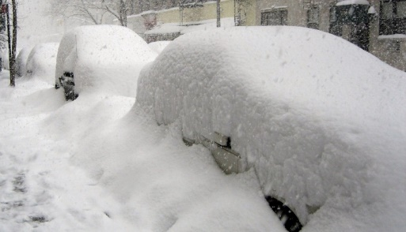
Inclement Weather
In the event of severe weather, driving
may be canceled. Notices will be sent via email and will be posted on the bulletin board.
If driving is not canceled, use your best judgment about driving. NEVER feel pressured to drive in conditions in which you are not comfortable.
Always call your site before you leave the UM to make sure they are open. This especially applies to schools, which may close for snow days.
Please allow the engine to warm up for a couple minutes before driving.

Slide 19
Vehicle Use Checklist
Departure & Return
  Complete Vehicle Report Form every time.
  Re-fuel if fuel gauge shows ½ tank or less.
  Remove trash and turn off any interior lights.
  Be sure all windows are closed.
  Lock vehicle while parked.

Slide 20
Review:
Steps to Using a Vehicle
Before leaving East Hall:
Retrieve keys from lockbox
Locate vehicle in garage
Fill out Vehicle Report Form on your phone
Before leaving volunteer site:
Upload pictures of any damage occurring at site, to Vehicle Report Form
After returning:
Update Vehicle Report Form
Return keys to lockbox

Slide 21
Three-Strike Policy
Earning three strikes will result in a meeting with the Transportation Coordinator and possible loss of driving privileges.
Strikes are most commonly earned by:
  Incomplete Vehicle Report Form
  Failing to send a complete set of pictures of the vehicle
  Parking in spots other than business/unmarked spots
  Damaging the vehicle
  Leaving trash/belongings in the vehicle
  Not re-fueling the vehicle when appropriate
  Leaving vehicle unlocked
  Not closing all windows

Slide 22
Loss of Vehicle Use
The following may result in immediate loss of vehicle use:
  Sharing the lockbox code with anyone
  Using a vehicle that you do not have reserved or isn’t assigned to you
  Taking a vehicle anywhere other than your site
  Having unauthorized passengers in the vehicle
  Not properly reporting damage or accidents
  Smoking in the vehicle
  Drugs or alcohol in the vehicle
  Operating a vehicle under the influence of drugs or alcohol

Slide 23
Inside the Vehicles:
Driver’s Visor
  Phone numbers for Psych SAA Office, DPS, and Transportation Services/University Garage.
Transportation Procedures Packet
  If you are unsure of what to do, all the information presented in this document is in the packet.

Slide 24

Important Dates
Each term has specific start and end dates and times.
Vehicles can not be used on dates that the UM is closed.

Slide 25
Next Steps
Complete the “Reserving a Vehicle and Completing the Vehicle Report Form” Module.
View the Transportation Orientation Video & Confirm Completion.

