Slide 1
Department of Psychology Transportation Orientation
Eligibility & Registration

Slide 2
Contact Information
Psychology Student Affairs Office
1343 East Hall
Open: Monday-Friday, 8am-5pm
Phone: 734-764-2580
Email: psych.transportation@umich.edu
EMERGENCY AFTER BUSINESS HOURS:
Call Transportation Services at: (734) 764-2490
Refueling: 1213 Kipke Dr, Ann Arbor, MI 48104

Slide 3
Eligibility & Registration
Eligibility:
Must be enrolled in Psych 211, 306, or 325
Must have a valid driver’s license.
Must be 18 years of age or older.
Must have less than 7 points on driving record.
Must complete the registration process.
Registration:
Motor Vehicle Record (MVR) Form
Online Transportation Course & Quiz
Transportation Orientation & Quiz

Slide 4
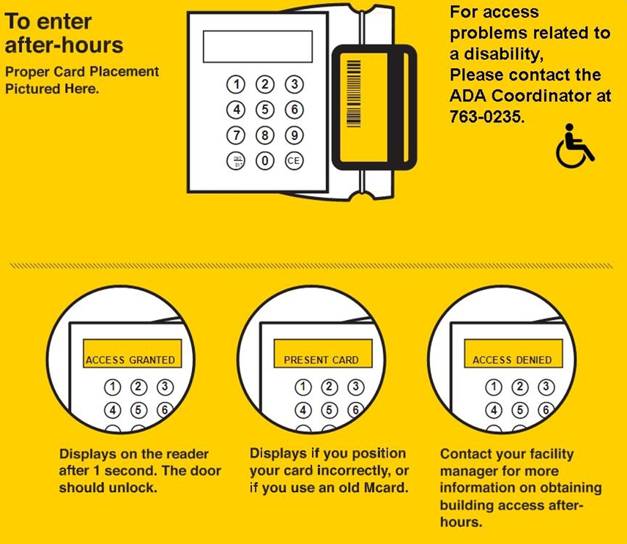
Access to East Hall
When using a vehicle after 6:00pm on weekdays (Fridays after 5:00pm), or anytime on weekends, you will need to use your Mcard to enter the building.

Slide 5
Your Next Steps:
Submit a Motor Vehicle Report (MVR) request
Review the Following Modules:
Using a UM Vehicle & Quiz
Reserving a Vehicle and Completing the Vehicle Report Form
View the Transportation Orientation Video and Confirm Completion

