Slide 1
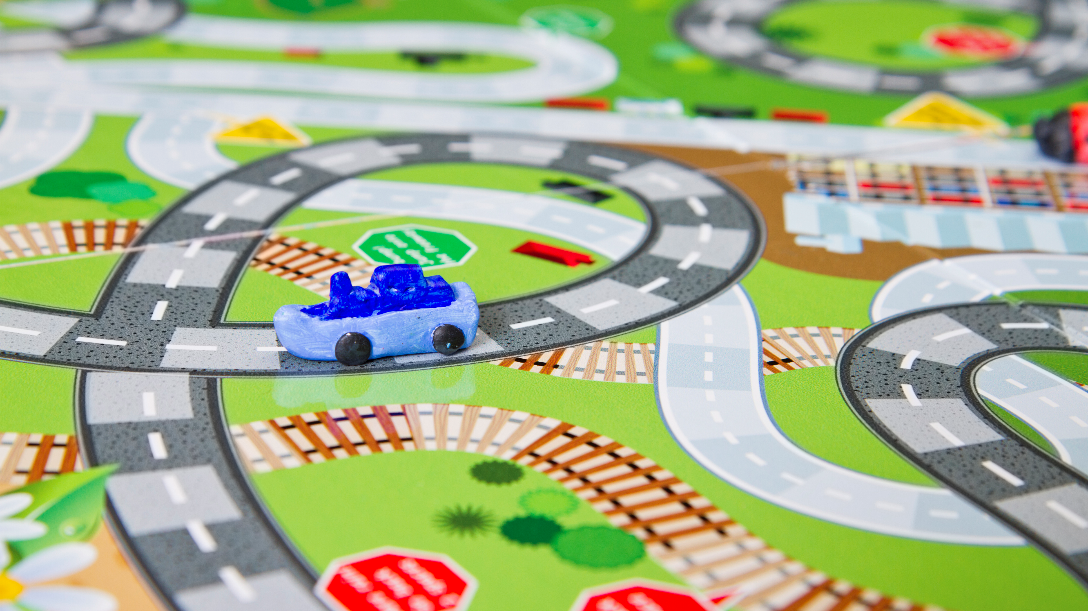
Editing Your Passengers & Drivers in Real Time
Department of Psychology Transportation Orientation

Slide 2
Contact Info
Psychology Student Affairs Office
1343 East Hall
Open: Monday-Friday, 8am-4:30pm
Phone: 734-764-2580
Email: psych.transportation@umich.edu
EMERGENCY AFTER BUSINESS HOURS:
Call Transportation Services at: (734) 764-2490
Refueling: 1213 Kipke Dr, Ann Arbor, MI 48104

Slide 3
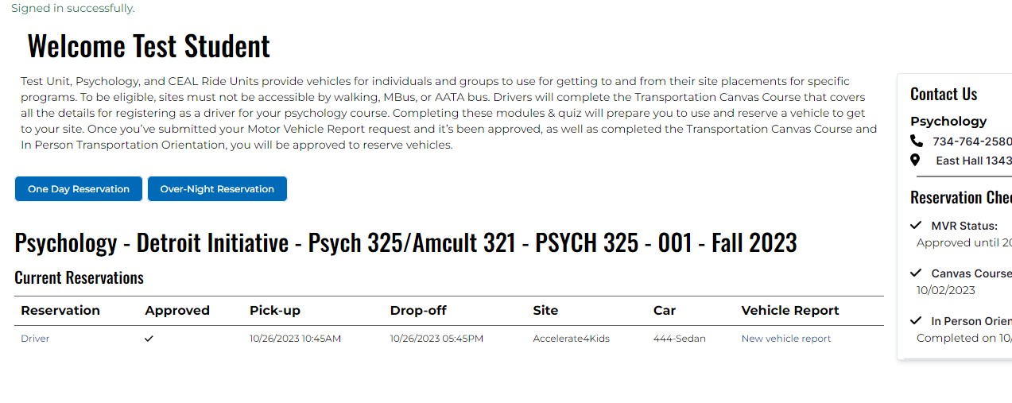
After logging into your Single Sign On (SSO) Umich Account, you will be brought to this dashboard, where you can see the “Driver” link,
Having an accurate passenger list is critical!
Once you click on the Driver link you will see the reservation information

Slide 4
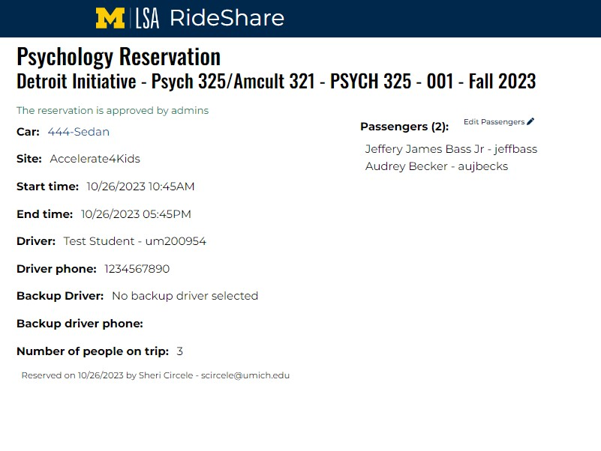
After clicking “Driver”, you will be directed to the reservation page. Here you’ll see that the number of people on the trip is 3 and under Passengers you see who they are. You cannot add more passengers than the reservation is set up for, but you can remove those who don’t go. Here you will need to click on “Edit Passengers”

Slide 5
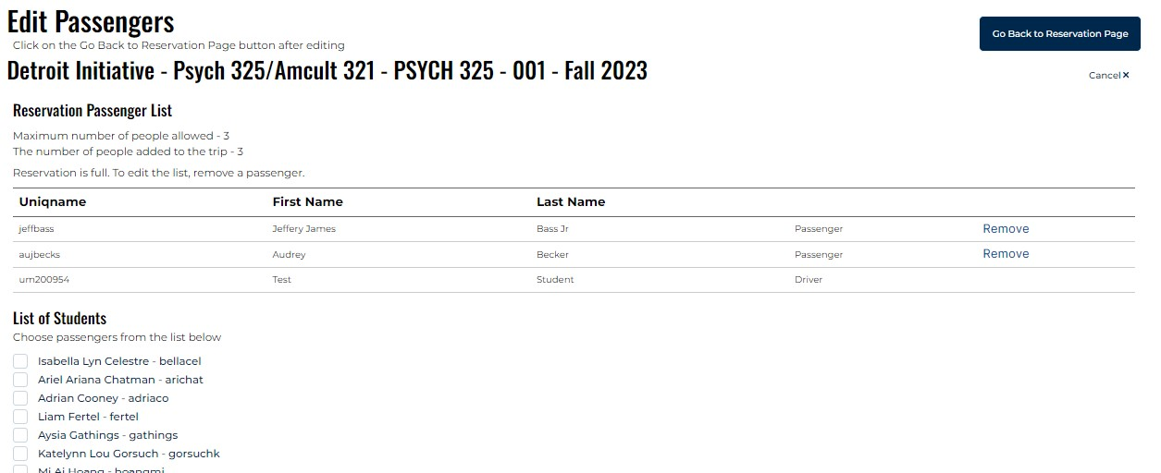
On the Edit Passengers page you can update your passengers. In this example let’s remove Audrey, she isn’t going to site today. Click the “Remove” link for Audrey and confirm the removal. Now you may go back to the Reservation Page.
Once you click on the “Remove”, Audrey will be removed from the reservation. You could add a new passenger at this point because you now have only 2 in group. If you only need to add a passenger, you will need to email psych.transportation@umich.edu to have the new passenger added.

Slide 6
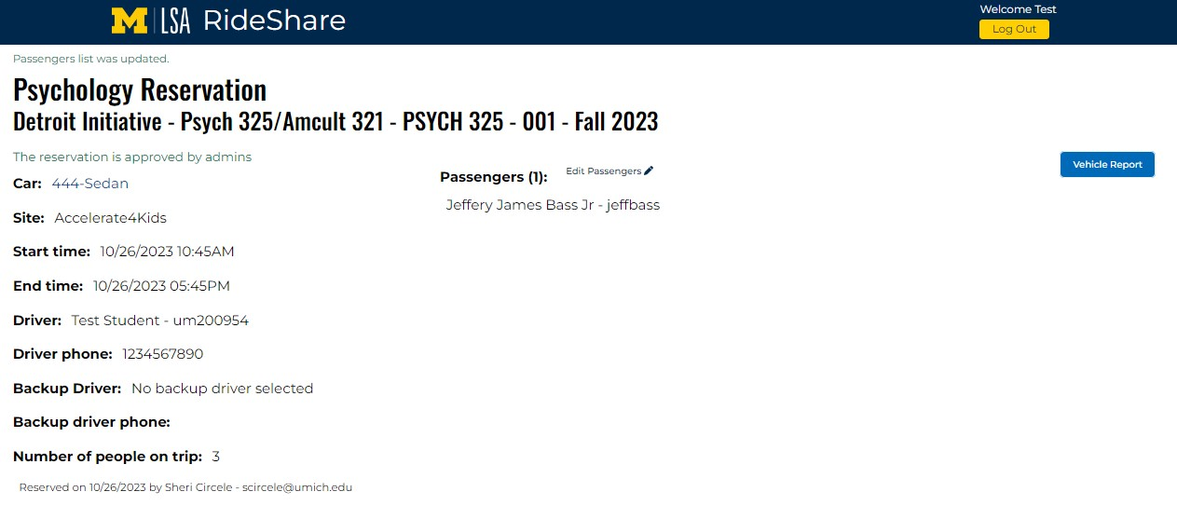
Now that you’re back at the Reservation page you can click the “Vehicle Report” button to proceed as usual.
Invite questions from the audience.

Slide 7
Key Point
Only the Driver of the reservation can edit the Driver, Back up Drivers cannot.
Back up drivers will need to email psych.transportation@umich.edu to have the reservation updated.
It is critical that we have an accurate list of those in the vehicle,
EVERY time it is used.
If you are having issues, please click/touch the "Report an Issue" at the bottom of the screen.
Questions?
Contact the Transportation Coordinator
in the SAA office (734-764-2580) or
email: psych.transportation@umich.edu

