Slide 1
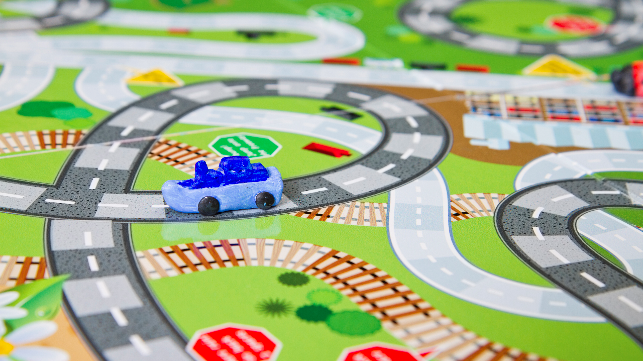
Part 1: Reserving a Vehicle
Department of Psychology Transportation Orientation

Slide 2
Contact Info
Psychology Student Affairs Office
1343 East Hall
Open: Monday-Friday, 8am-4:30pm
Phone: 734-764-2580
Email: psych.transportation@umich.edu
EMERGENCY AFTER BUSINESS HOURS:
Call Transportation Services at: (734) 764-2490
Refueling: 1213 Kipke Dr, Ann Arbor, MI 48104

Slide 3
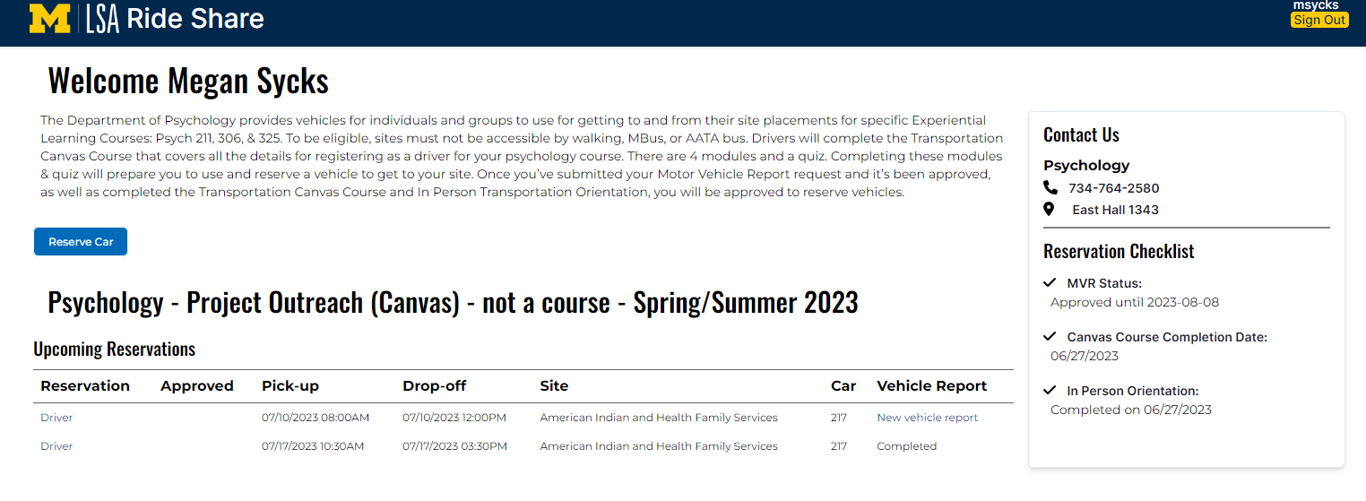
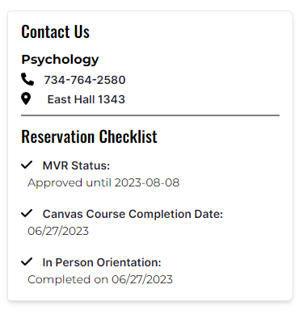
After logging into your Single Sign On (SSO) Umich Account, you will be brought to this dashboard, where you can see the “Reserve Car” button, any previous reservations, and your Reservation Checklist.
Invite questions from the audience.
Once this Checklist is completed, you will be able to move forward with reserving a car. You can refer to this page to check your status.

Slide 4
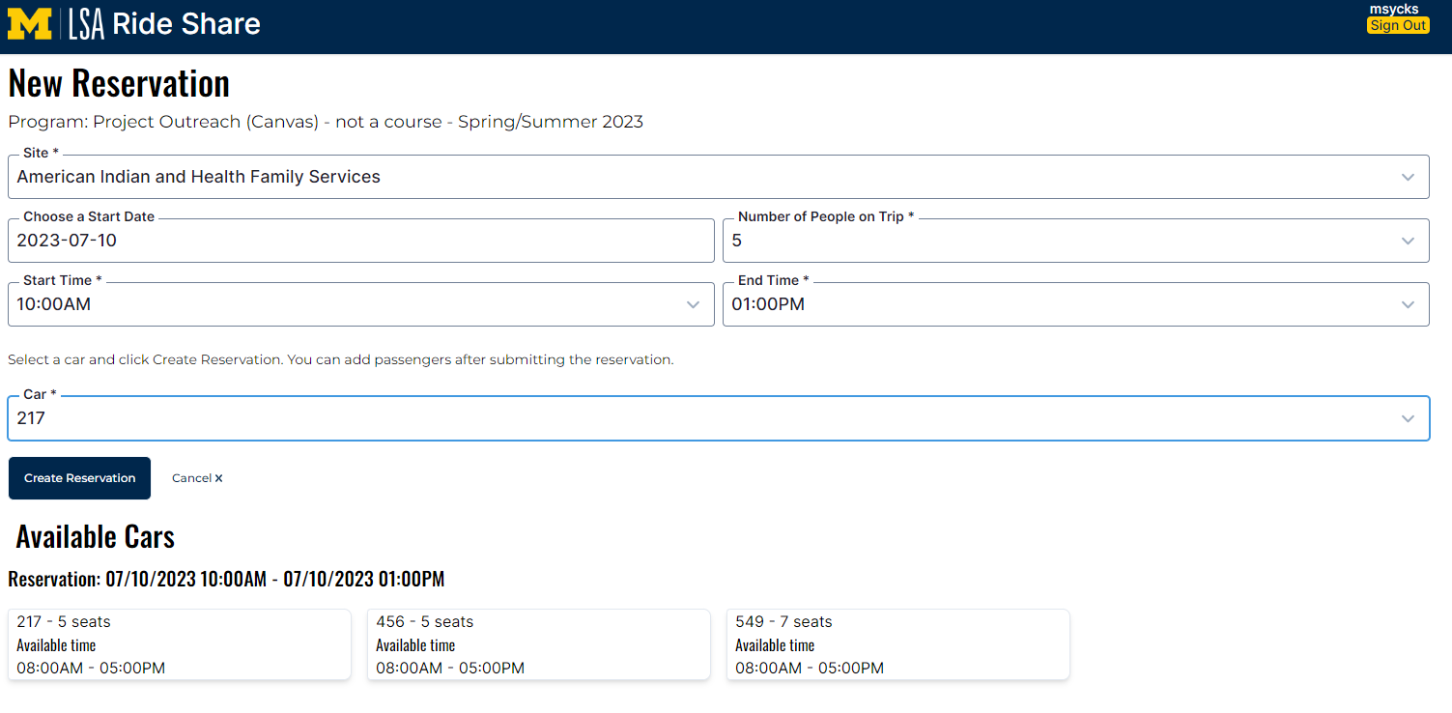
After clicking “Reserve Car”, you will be directed to this page. Here you will need to complete all required fields and then select an available car to complete the reservation.
Invite questions from the audience.
In this example, you can see that:
The student is going to American Indian Health and Family Services
The car will be used on 7/10/23 from 10:00 am – 1:00 pm
There are 5 students in the group
They will be driving vehicle 217

Slide 5
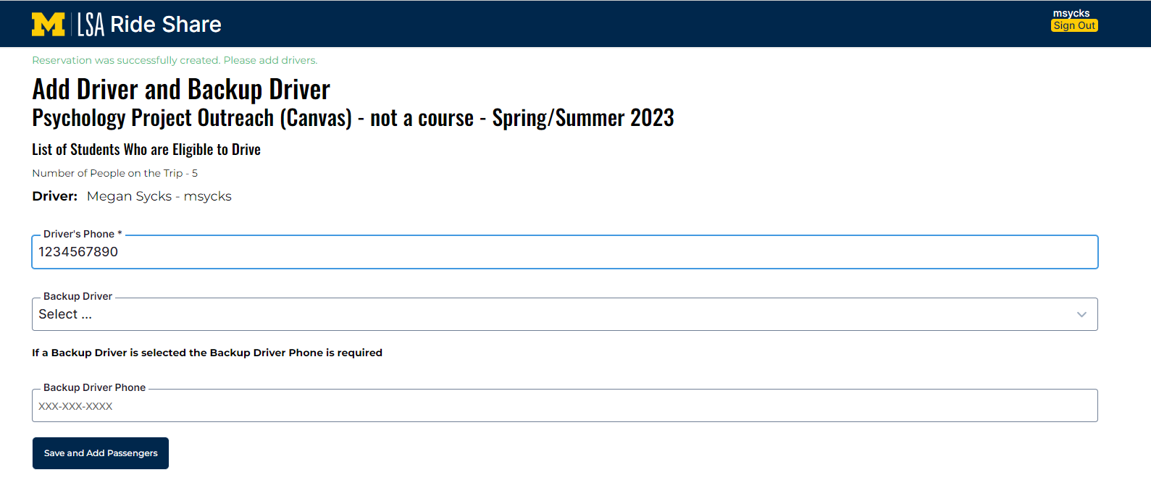
Once the reservation is created, you will be prompted to add Driver and Backup Driver information. Please note that not every group will have a Backup Driver.
Invite questions from the audience.

Slide 6
Next, you will add your passengers. Students in the course will be listed at the top and will appear under your list of passengers after they are selected. Once all passengers are added, click “Finish Creating Reservation” to save your changes.
Invite questions from the audience.

Slide 7
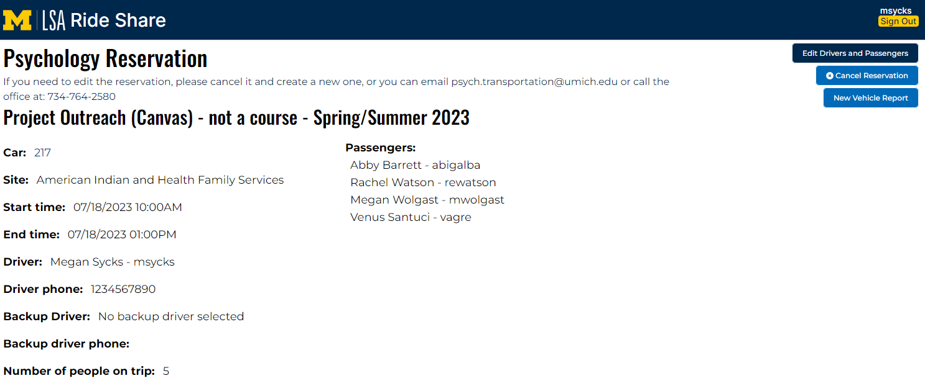
Once you are finished, you will be directed to this confirmation page. If you need to edit driver/passenger information or cancel the reservation, you can do so here.
Invite questions from the audience.

Slide 8
Below is an example of the confirmation email you will receive once a reservation is created. You will receive another email once your reservation is approved.
Invite questions from the audience.

Slide 9
Key Points
You will need to complete your MVR, the Canvas Course & Quiz, and the Transportation Orientation Video & Confirmation before you are able to create reservations.
Reservations need to be made more than 3 business days (72 hours) in advance of need.
All reservations need to be approved before using the vehicle.
Groups of 5 or less should reserve a sedan. If none are available, you may reserve a mini-van.
Groups of 6-7 will reserve a mini-van.
If you are having issues, please click/touch the "Report an Issue" at the bottom of the screen.
Questions?
Contact the Transportation Coordinator
in the SAA office (734-764-2580) or
email: psych.transportation@umich.edu

Slide 10
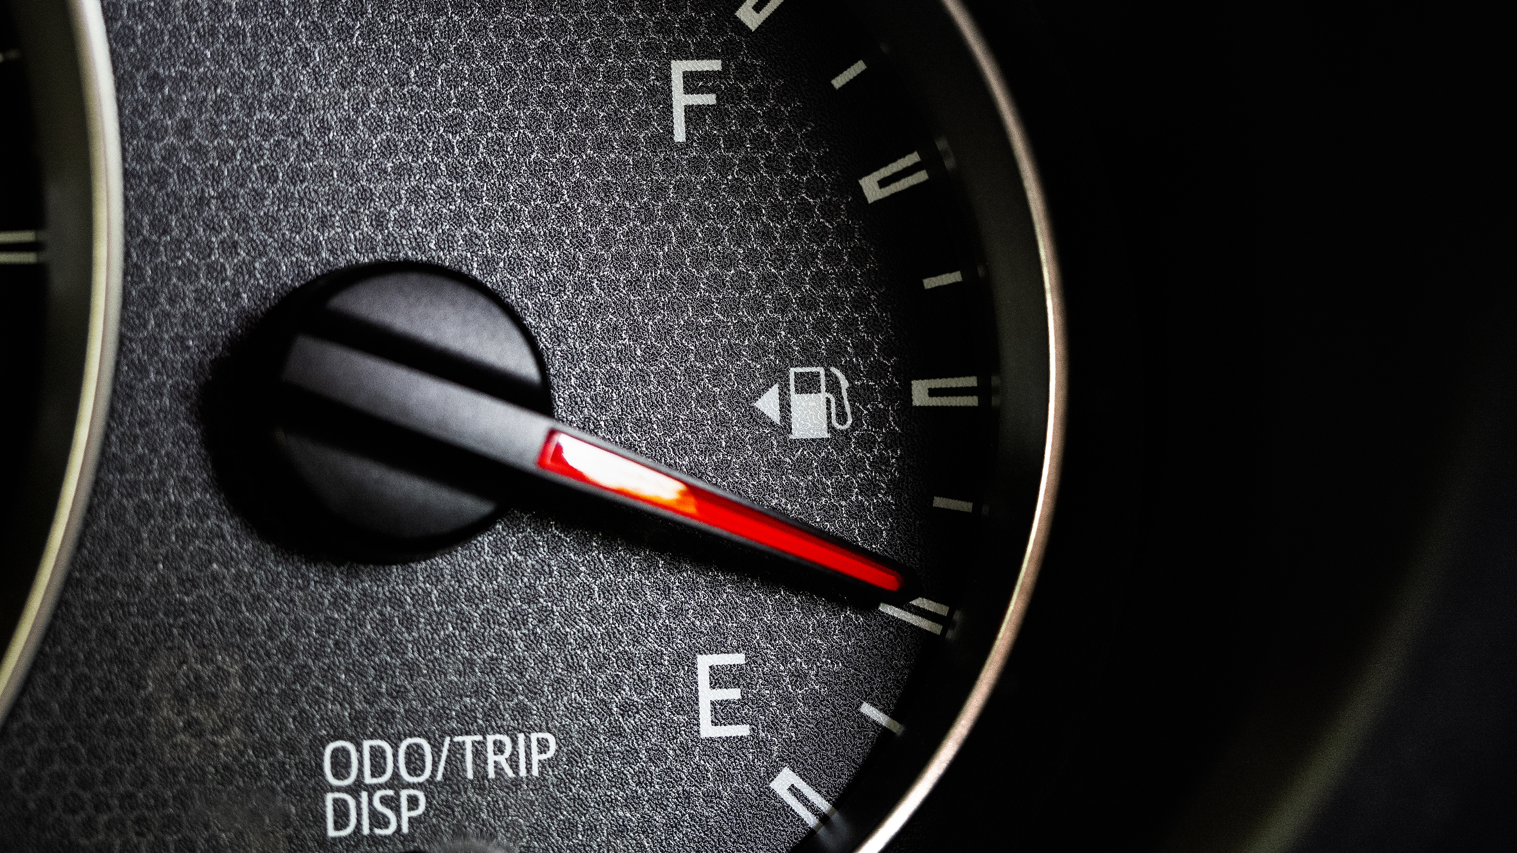
Part 2: Completing the Vehicle Report Form
Department of Psychology Transportation Orientation

Slide 11
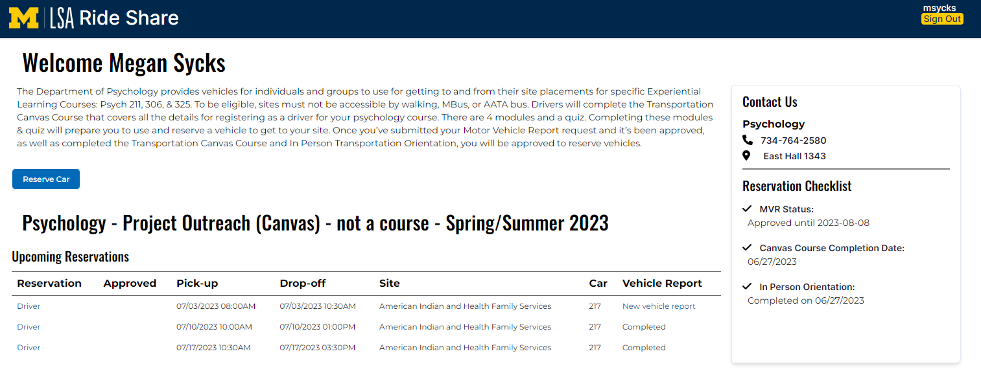
Back on your home page, click “New vehicle report” when you’re ready to drive the car during your approved reservation.
Invite questions from the audience.

Slide 12
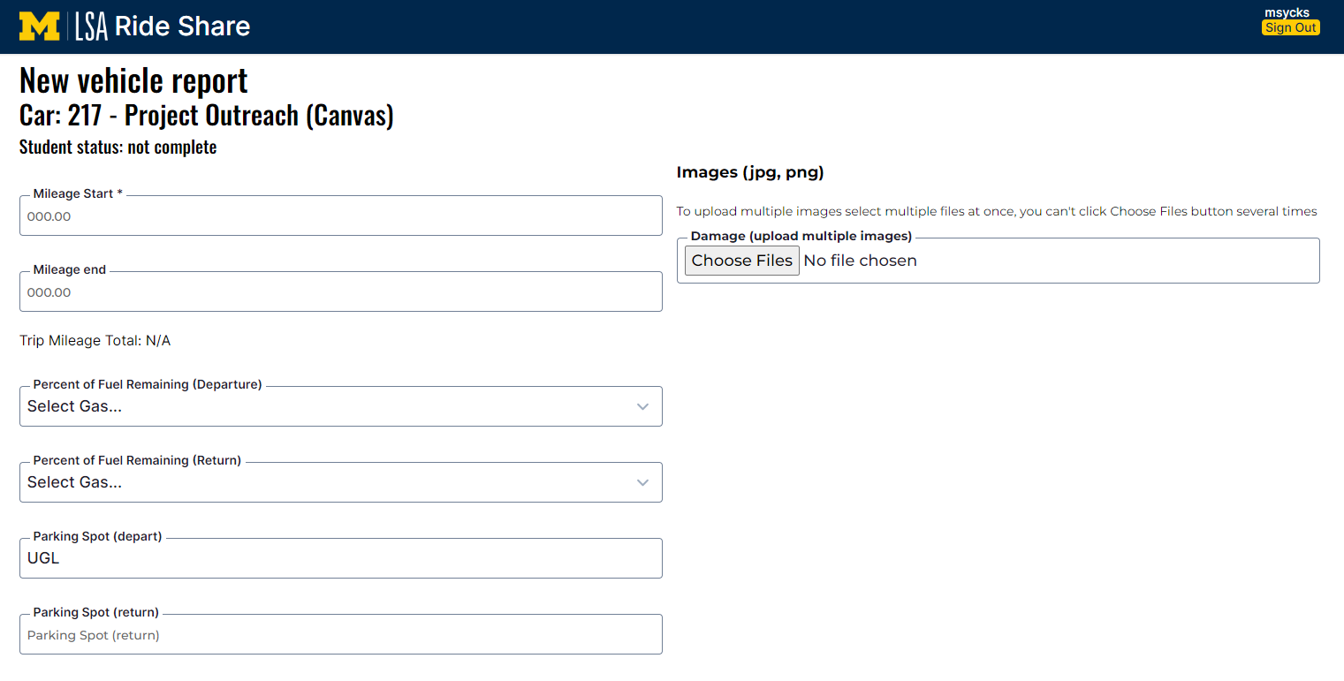
Here is an example of how a new Vehicle Report Form will look. Notice that the parking spot will pre-populate, so you are able to locate it in the garage.

Slide 13
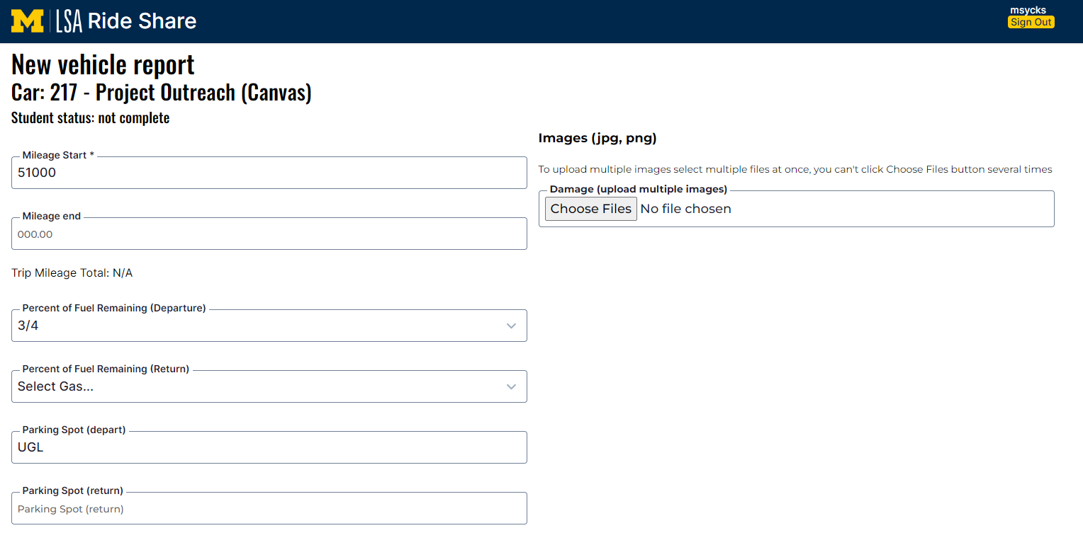
The first time you use the form, you will need to complete the following fields: - Mileage Start - Percent of Fuel Remaining (Departure)
Please note that uploading images is only required if there are damages to the vehicle - you do not need to submit pictures every time.
The comment box is a useful tool for letting the Transportation Team know about vehicle maintenance, issues with the form, etc.

Slide 14
Once you finish completing your vehicle report, you will be directed to this confirmation screen.
Once you return from your site, click
“Edit Vehicle Report”
After this step, you should drive to your site. As long as no damages occur on your trip, nothing more is required until you return to the garage.

Slide 15
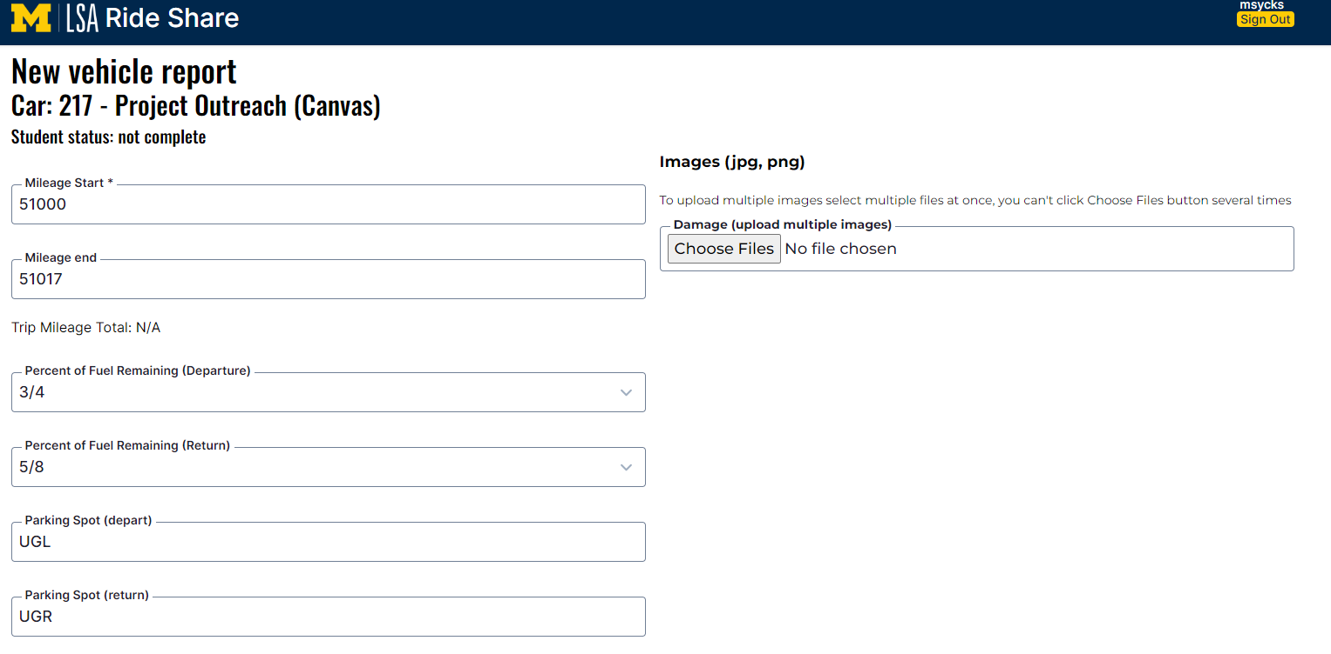
Upon returning, complete the following fields: - Mileage end - Percentage of Fuel Remaining (Departure) - Parking Spot (return)
You can fill out the comment box as necessary, like the example shown here.

Slide 16
After completing the form, you will be redirected back to this confirmation page – now showing the form as “Completed”. This completed form will be reviewed by the Transportation Team.

Slide 17
Vehicle Photo Policy
In most cases, you will use the same vehicle for the entire term.
The first time you use the vehicle, you will do a FULL inspection prior to leaving the garage.
-Note any damage. This includes scuffs, scraps, dents, etc….
-Upload a photo(s) to the Vehicle Report Form.
-Remember these issues, from here on you will only report any NEW damage.
Each time you use the vehicle you will do a full inspection before you leave the garage. Upload a photo(s) of any NEW damage.
Each time before you leave the site, do another inspection. There have been times a vehicle has been hit at site, and we need to be aware of this. Upload a photo(s) of any damage caused at site.
Email psych.transportation@umich.edu if you have any questions.

Slide 18
Monitoring Vehicles
Mileage and vehicle condition are monitored daily by the office.
Any discrepancy in mileage or un-reported damage to the vehicle will be reported to both your GSI and faculty instructor and could result in the loss of driving privileges.
Damage to Vehicles
Any damage to vehicles must be reported to the SAA Office.
Upload pictures of damage to the Vehicle Report Form.
If you cause damage, you will fill out an accident report with the Transportation Coordinator. This is so we have a record of the incident.

Slide 19
Next steps:
View the Transportation Orientation Video and Complete the Confirmation.

