Slide 1
Department of Psychology Transportation Orientation
Motor Vehicle Report (MVR) Request

Slide 2
Contact Information
Psychology Student Affairs Office
1343 East Hall
Open: Monday-Friday, 8am-5pm
Phone: 734-764-2580
Email: psych.transportation@umich.edu
EMERGENCY AFTER BUSINESS HOURS:
Call Transportation Services at: (734) 764-2490
Refueling: 1213 Kipke Dr, Ann Arbor, MI 48104

Slide 3
MVR Instructions
psych.transportation
Fill in the name fields. Your unique name will autofill.
Fill in the remaining fields as in the above screenshot.
Leave UMOD Group Ownership field blank.
Go to the My Status Tab.

Slide 4
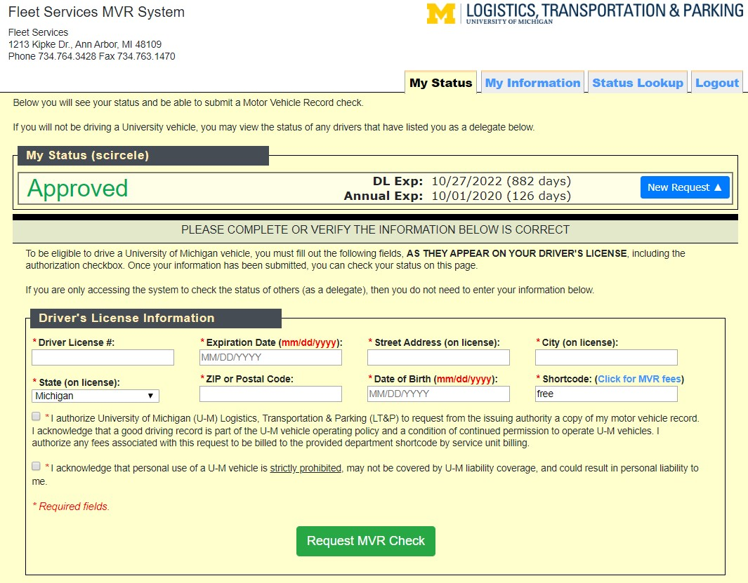
MVR Instructions:
My Status: The first time you login there will be no status.
Click on the New Request button to open the form.
Fill in your information and for the shortcode
Detroit (Psych 325)
ProjO (Psych 211 & 306
Check both boxes.
Click the Request MVR Check button.
If done correctly, the status at the top will indicate Submitted.

Slide 5
MVR Process
Congratulations! You’ve submitted your MVR request and completed the first step to becoming an approved driver.
You & the Transportation Coordinator will receive an email about your status & when you’ve been approved by Transportation Services.
You will also receive an email if there is an issue that you need to address. Reply ASAP so that your privileges are not delayed.
A cheat-sheet for filling out the form is available on the Transportation Canvas MVR Module.

